Slide 1

Task 1: Create a Resource Group

Slide 2
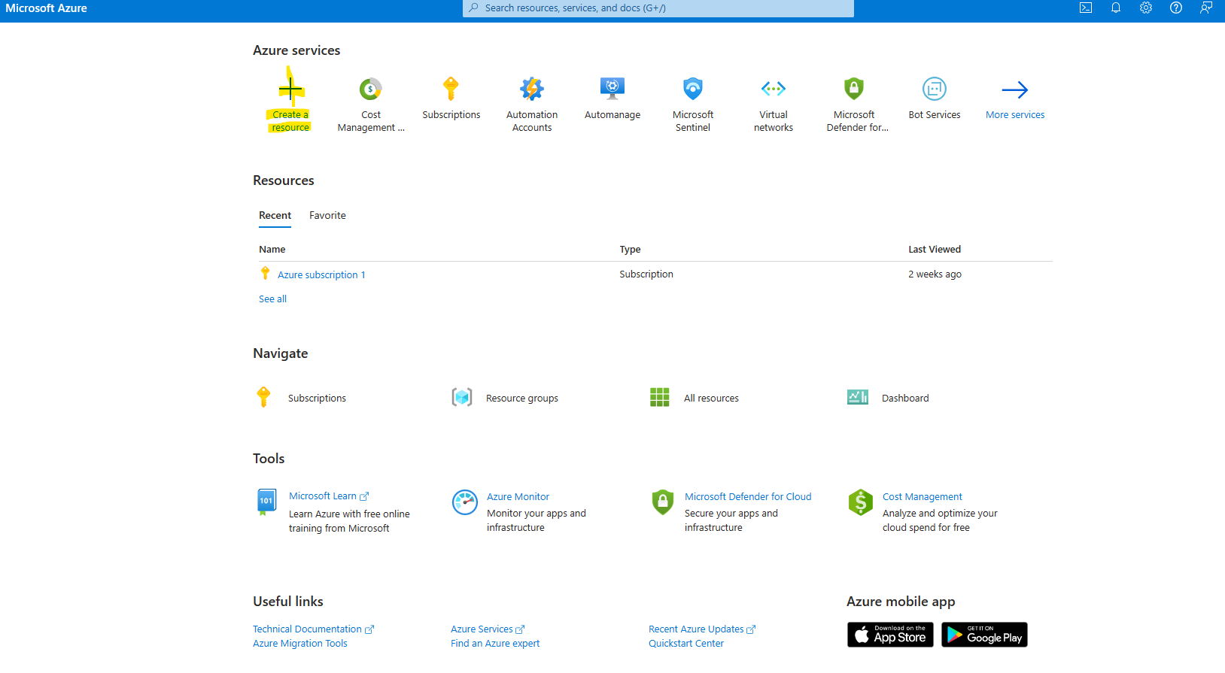
Select Create a resource

Slide 3
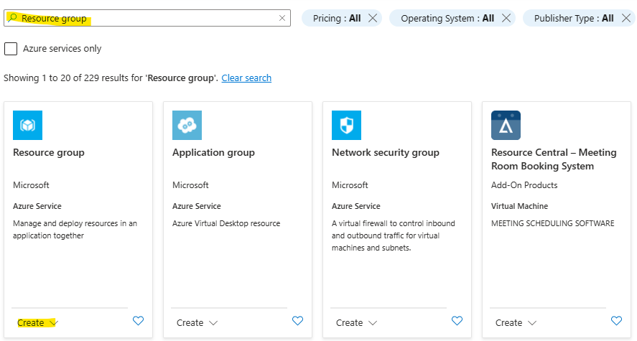
Search for and create a resource group

Slide 4
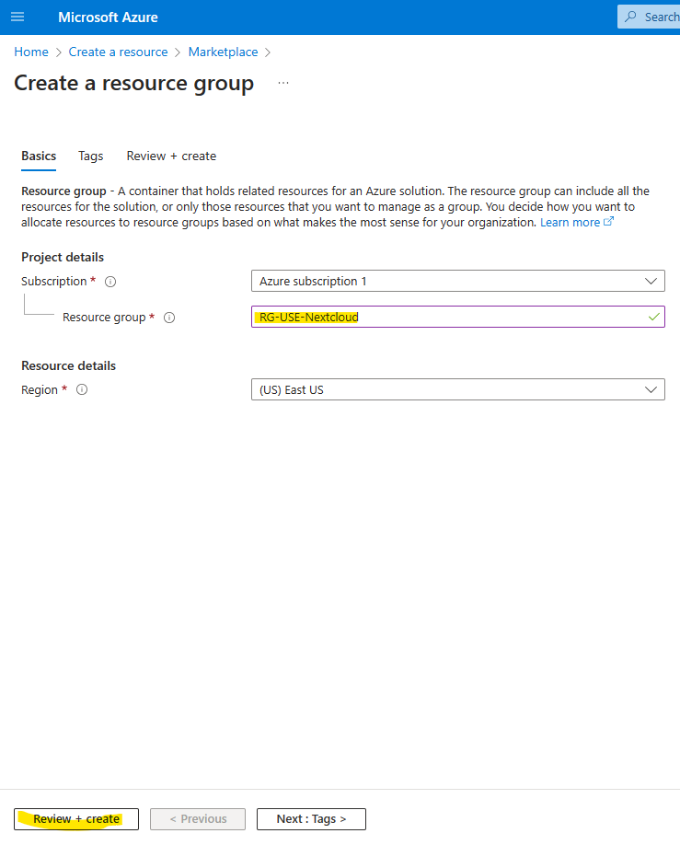
Name Resource Group You may use a standard naming convention such as Resource Group – Region – Server Type.
Named Resource Group: RG-USE-Nextcloud
RG – Resource Group
USE – Region
Nextcloud – Server type
Then select Review+Create and then create

Slide 5
Task 2: Create a Virtual Network and a subnet

Slide 6
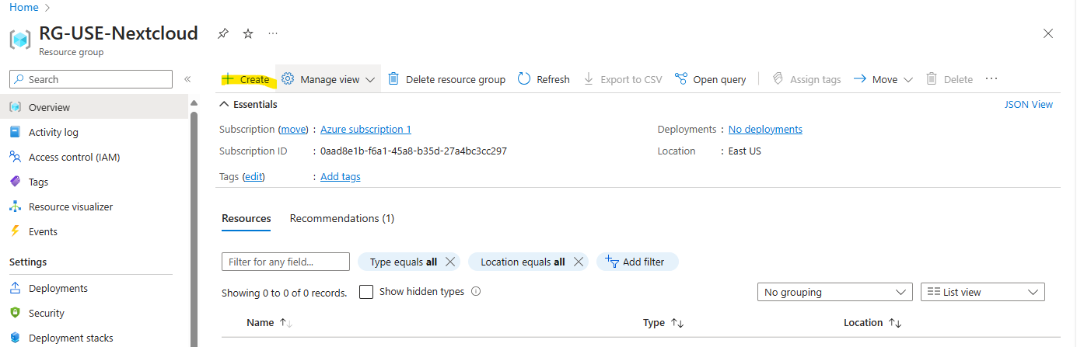
Add a virtual network to the resource group with a subnet
First step would be to select the + Create button

Slide 7
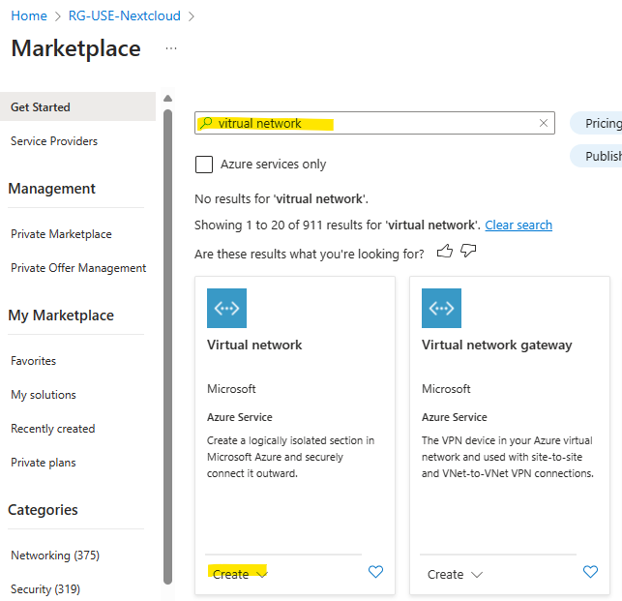
Search for and create Virtual Network

Slide 8
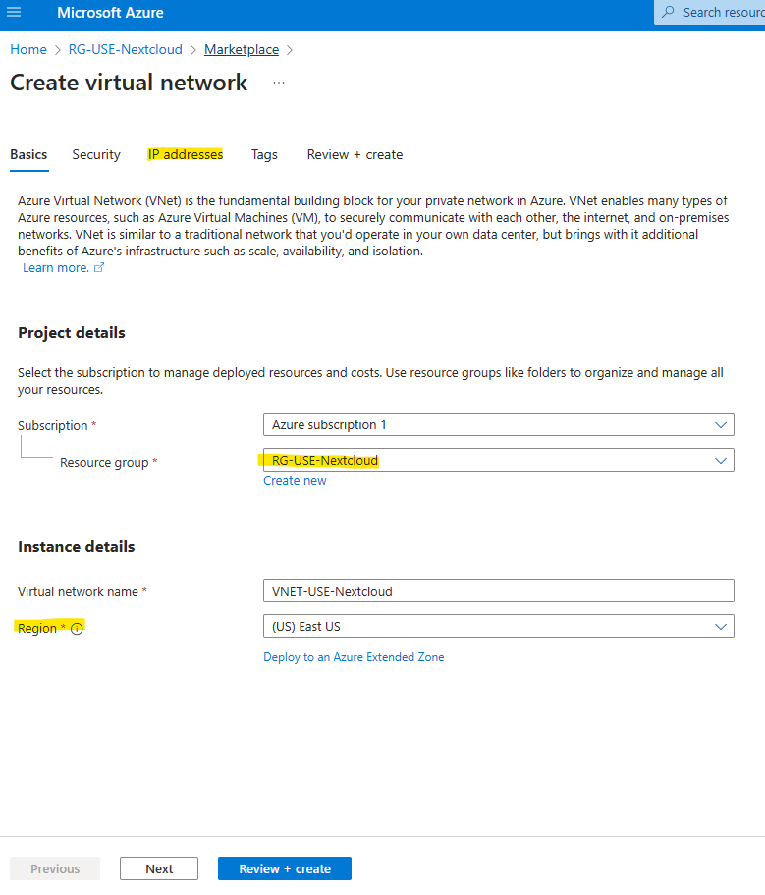
Name Virtual Network
Use the same naming convention as the resource group
Note: The region for your virtual network needs to be the same as the region for your resource group.
Then select IP Addresses

Slide 9
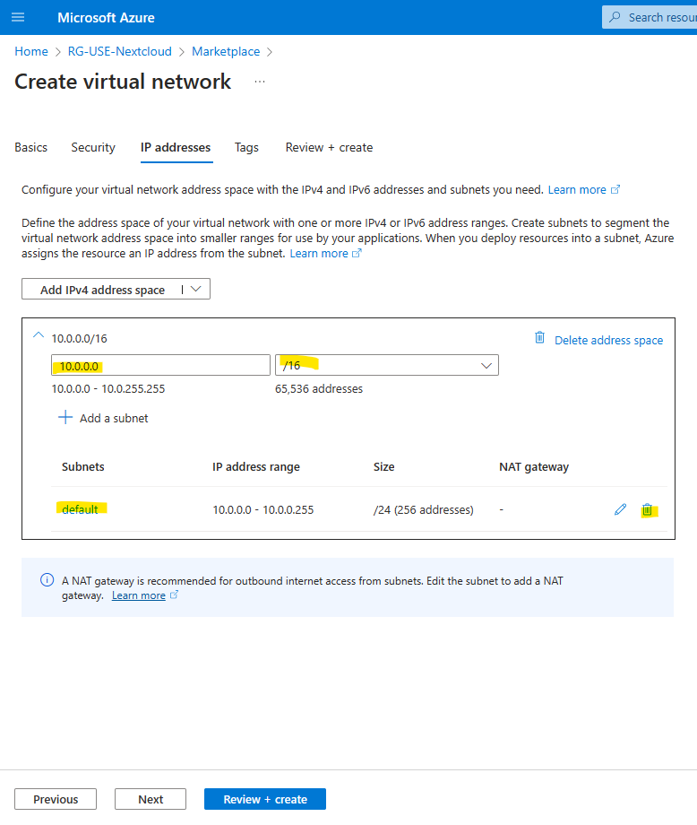
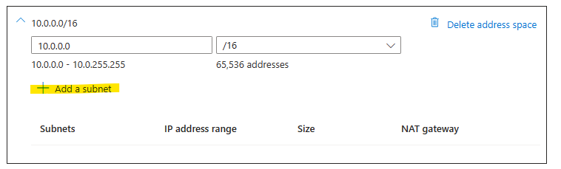
IP Addresses
IP Address default is good for our purposes but we need a different subnet address. Delete the default subnet ip address.
Then click + Add a subnet to add a new subnet ip address

Slide 10
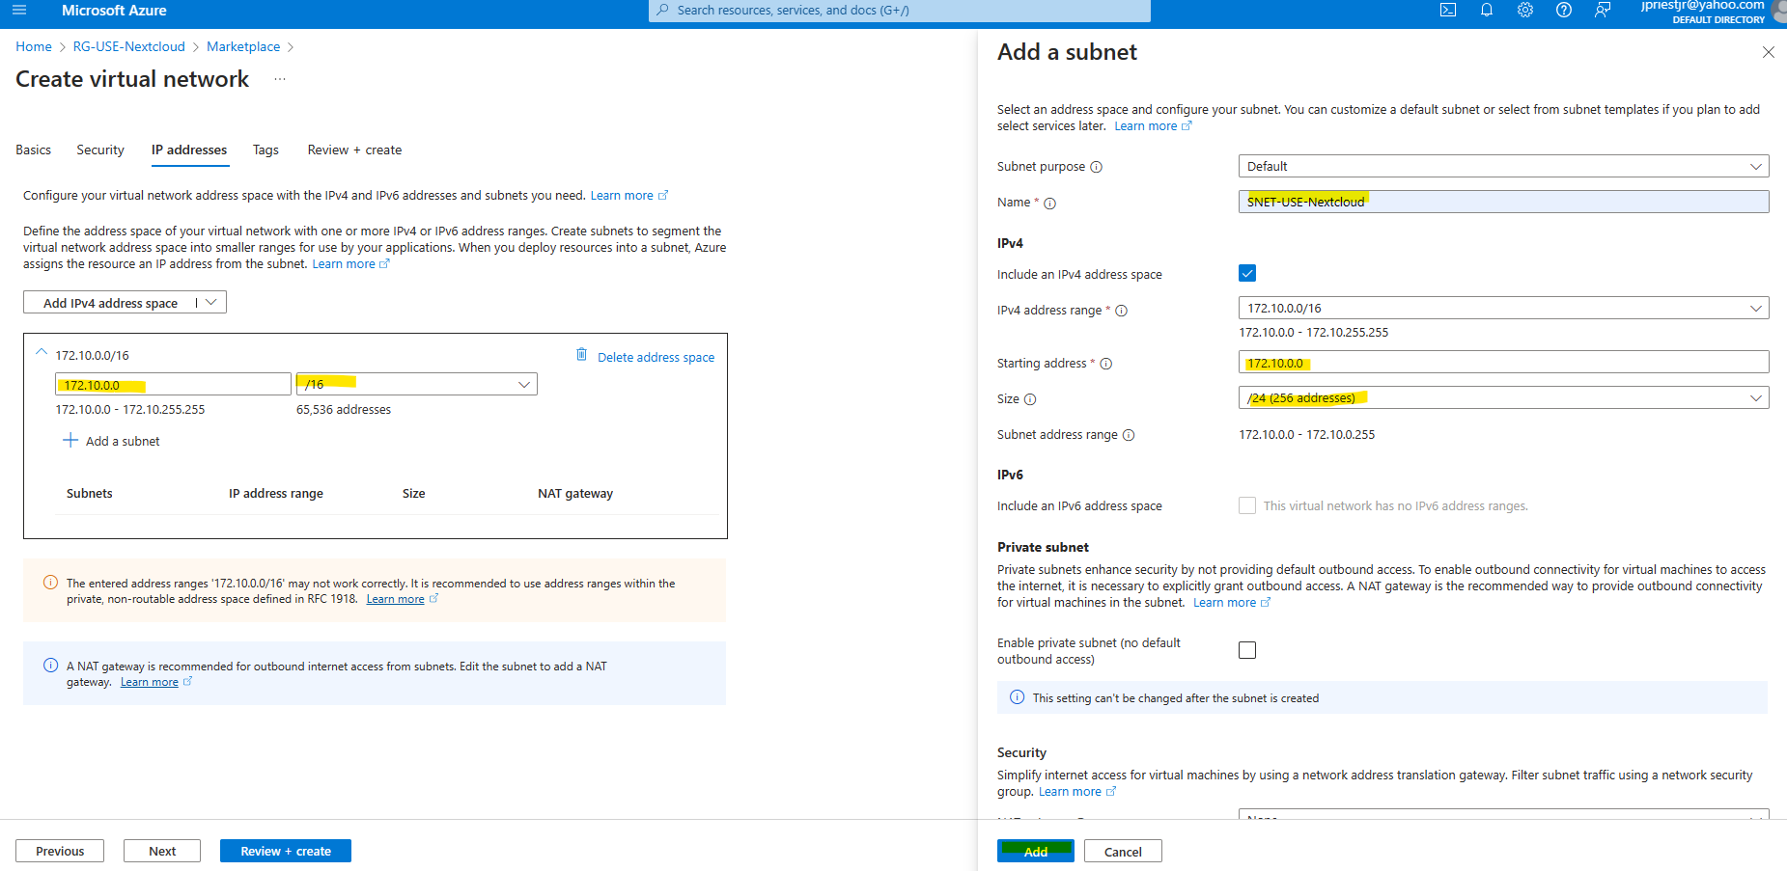
Subnet IP Address
Give your subnet an IP address (172.10.0.016.
Name your subnet using same naming convention used previously.
Check starting IP address and address range.
Click on Add when you are ready.
Review summary on next page and if ok, click on create.

Slide 11
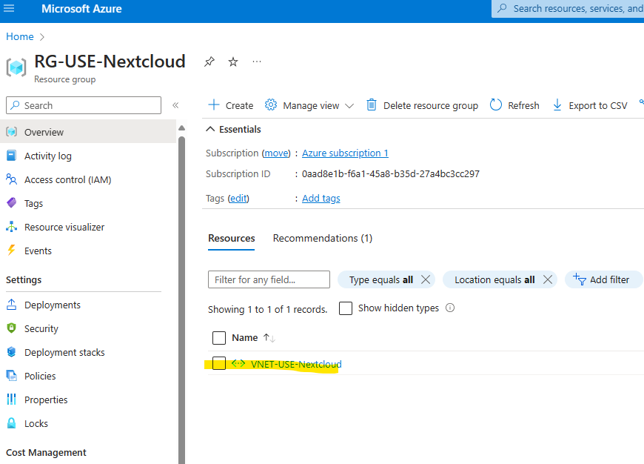
Resource Group Verification
Wait a few minutes and then click on the resource group to confirm addition of VNET.

Slide 12
Task 3: Protect a subnet using a Network Security Group

Slide 13
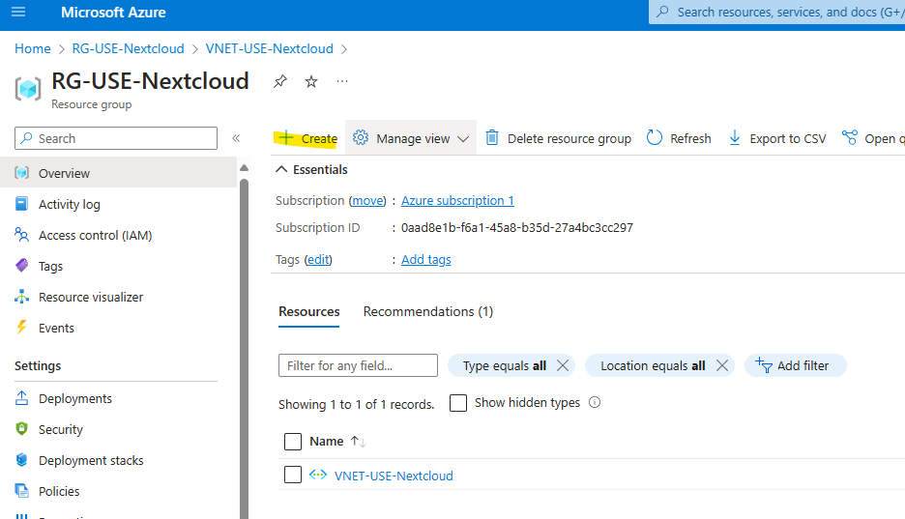
Create a Network Security Group
Make sure you are within the correct resource group and then click on create.

Slide 14
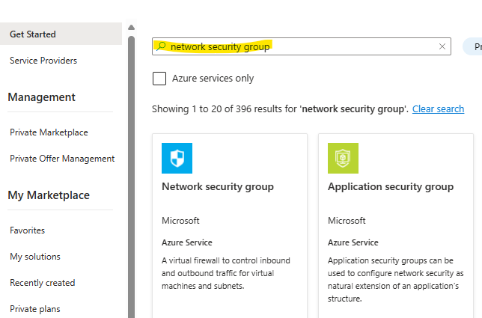
Create a Network Security Group
Search for Network Security Group and then click on Create.

Slide 15
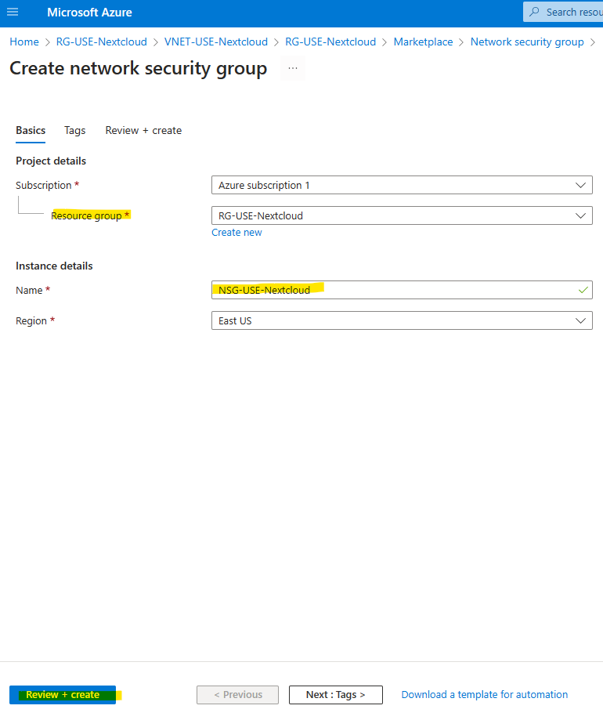
Create a Network Security Group
Verify Resource Group is correct.
Name your NSG using previously used conventions.
Then select Review+create

Slide 16
Create a Network Security Group
Verify Resource Group is correct.
Name your NSG using previously used conventions.
Then select Review+create
And then create.

Slide 17
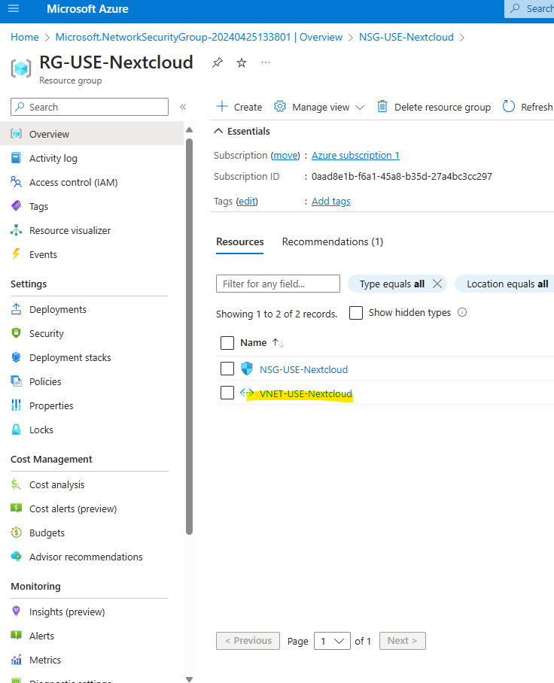
Assign the NSG to the Virtual Network
Go back to the virtual network.

Slide 18
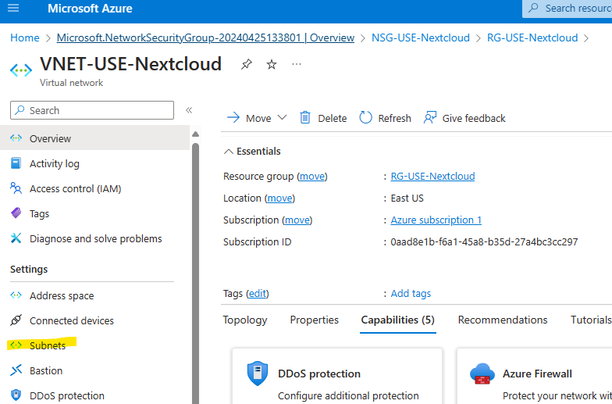
Assign the NSG to the Virtual Network
Click on Subnets

Slide 19
Assign the NSG to the Virtual Network
Click on Subnets

Slide 20
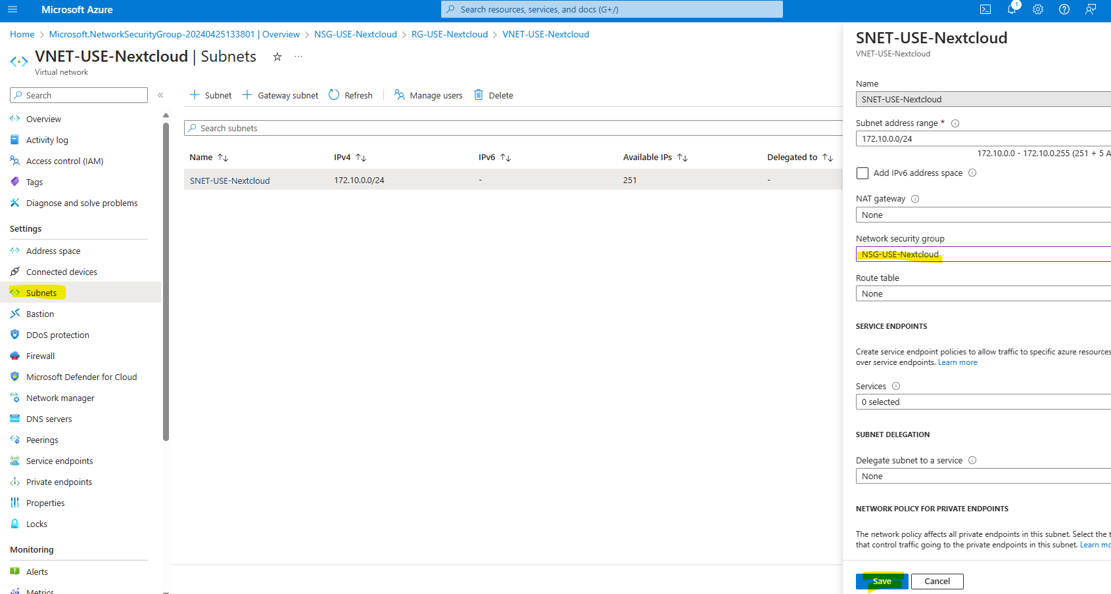
Assign the NSG to the Virtual Network
Click on your subnet
Then use the drop down for Network security group and choose the NSG you just made.
Then click Save.

Slide 21
Task 4: Deploy Bastion to connect to a Virtual Machine

Slide 22
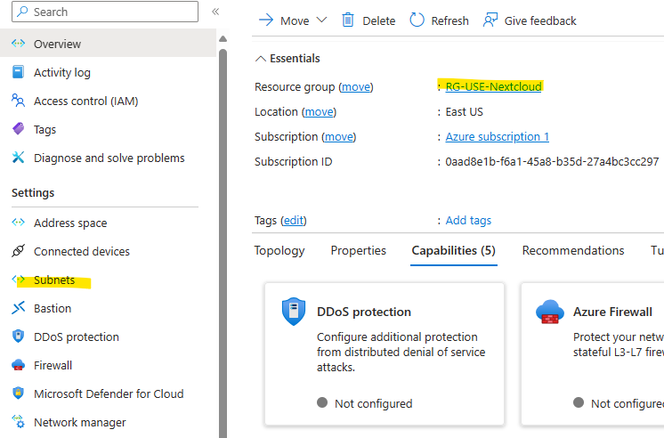
Create a Subnet for Bastion
Start at your VNET and then click on Subnets

Slide 23
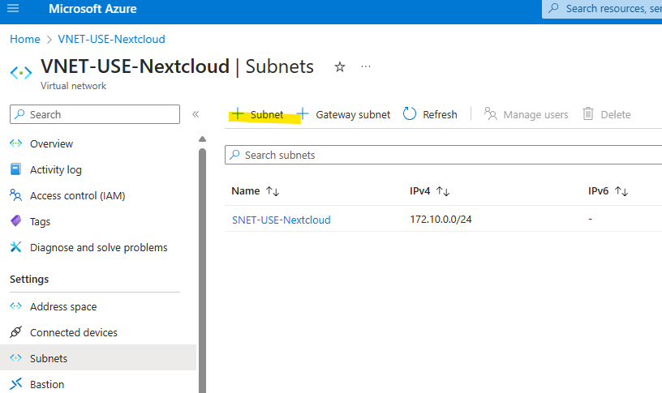
Create a Subnet for Bastion
Add a new subnet by clickin + Subnet

Slide 24
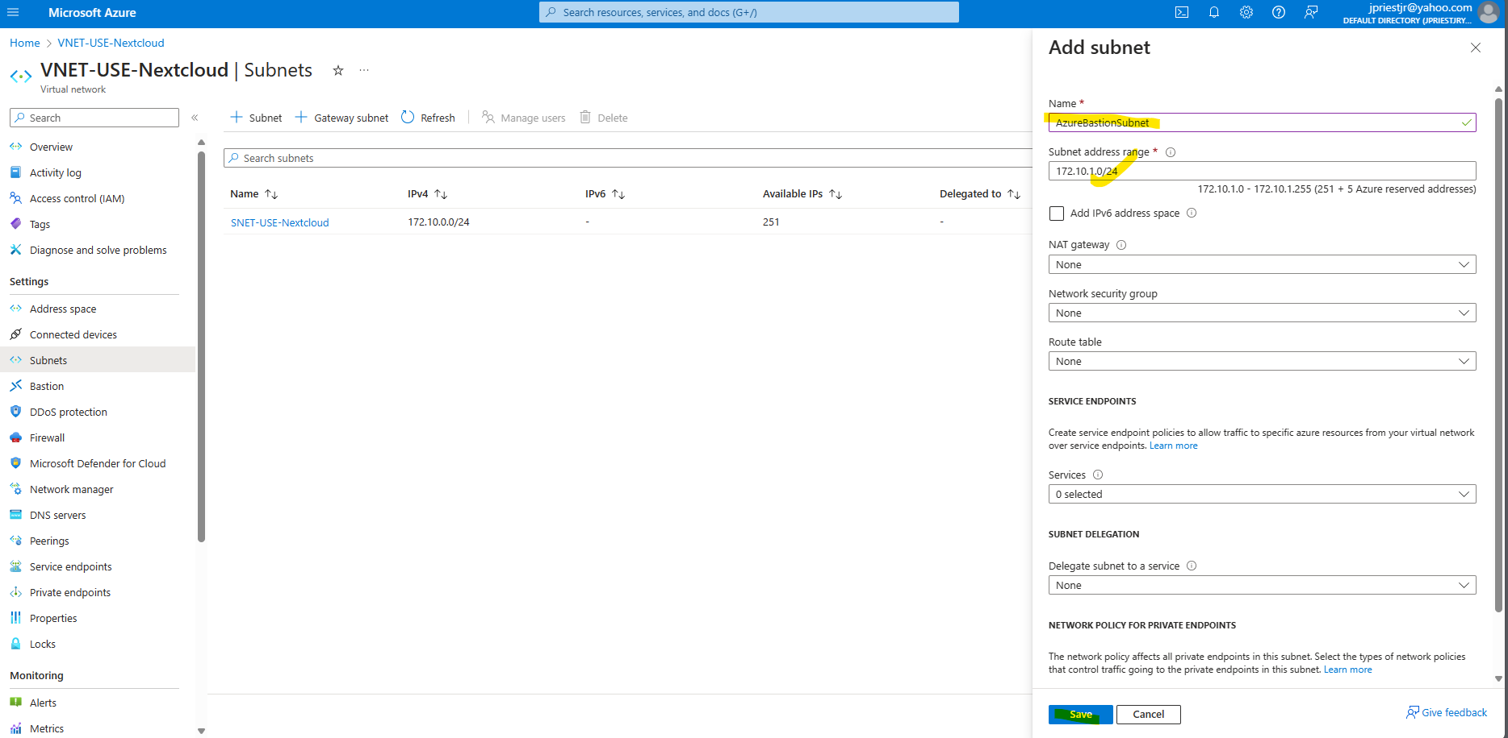
Create a Subnet for Bastion
Name your Subnet for Bastion Subnets it is required to be named AzureBastionSubnet.
Then click Save.

Slide 25
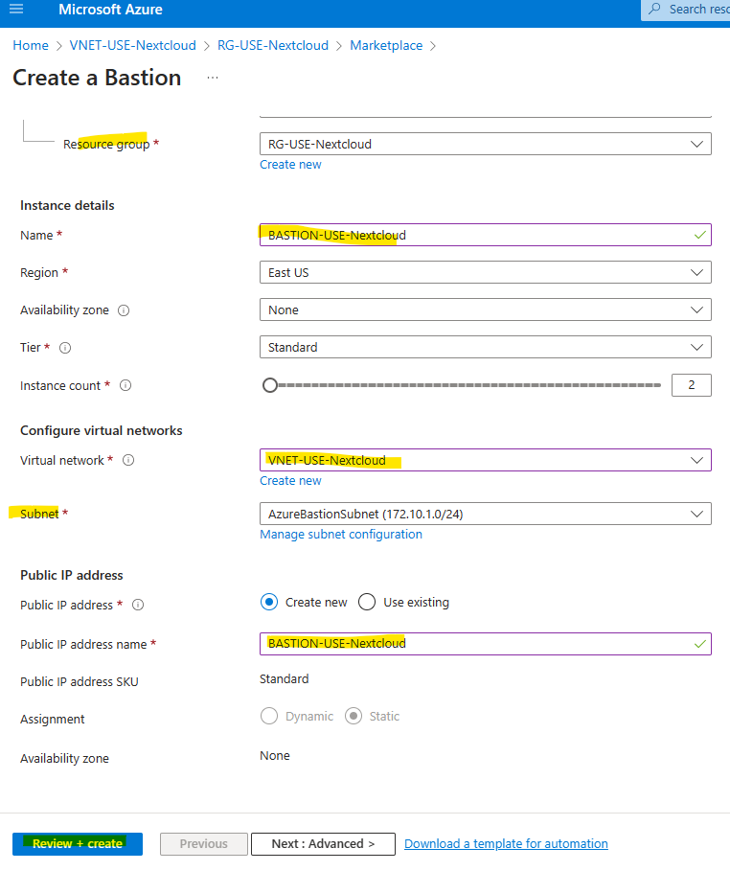
Adding Bastion
Go back to VNET and click +Create
Search for Bastion
Then Create
**Steps above not shown as it is the same as previous steps.
Verify resource group, Name your Bastion Instance, verify correct virtual network chosen, verify Subnet, and name Publick IP address name.
Select review+ create and then create.

Slide 26
Task 5: Create an Ubuntu Server Virtual Machine

Slide 27
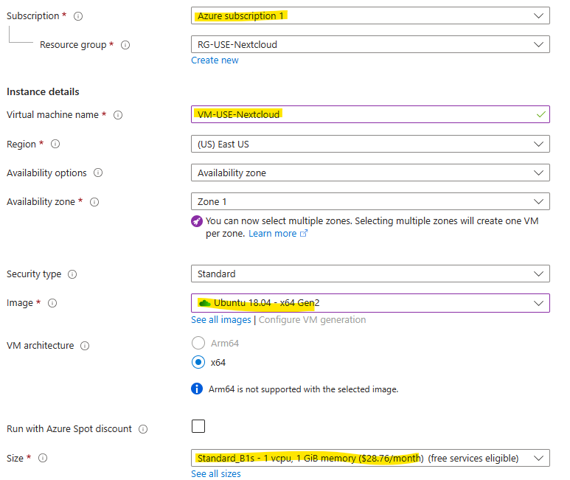
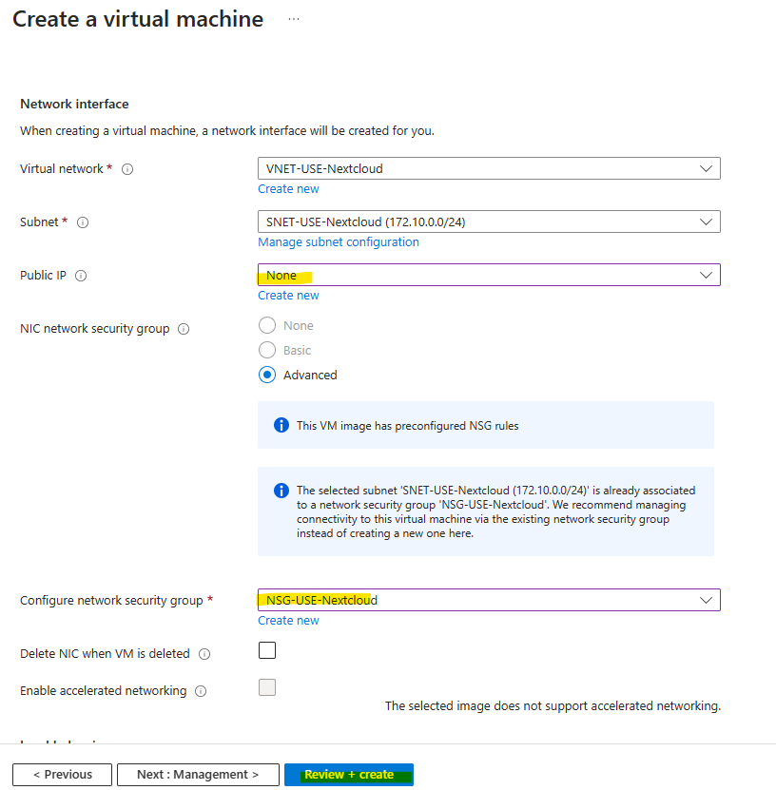
Create Ubuntu Server Virtual Machine
Go back to VNET and click +Create
Search for Ubuntu Server
Then Create
**Steps above not shown as it is the same as previous steps.
Name Virtual Machine
Select Image
Select Size
Change Username to something you will remember.
Then click next and next
Change Public IP to none and verify NSG is correct.
Then click on Review an create, create, and download key pair.

Slide 28
Task 6: Install Nextcloud by connecting via SSH using Bastion

Slide 29
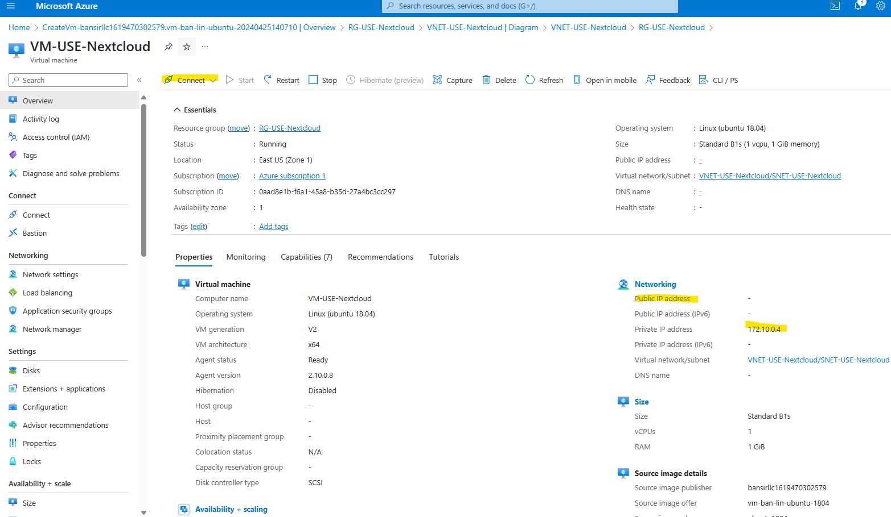
Connect VM via SSH using Bastion
Go to VM and click connect and choose Bastion.
Notice before hand that there is no public IP address and the private ip address (take note).

Slide 30
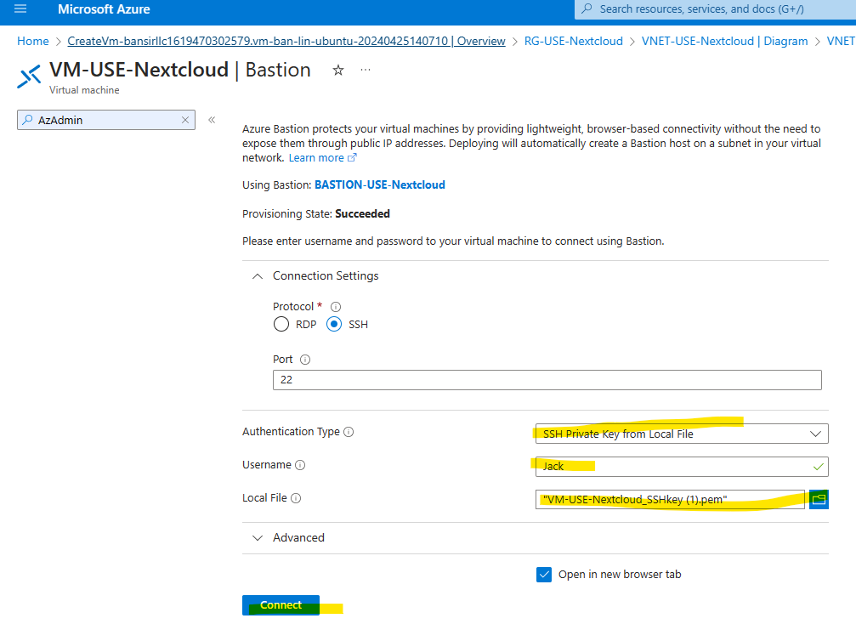
Connect VM via SSH using Bastion
Change Auth type to SSH Private Key, Type in Username, upload file for SSH Key into local file, and then click connect.

Slide 31
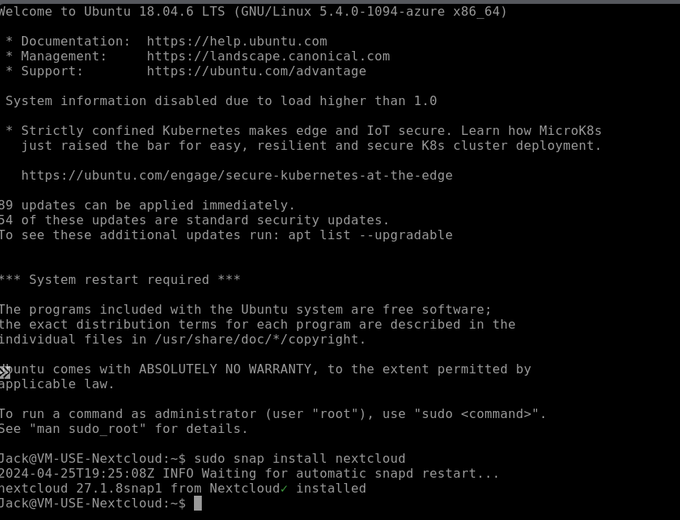
Nextcloud Installation
Type sudo snap install nextcloud and press enter.
It will take some time and install Nextcloud.

Slide 32
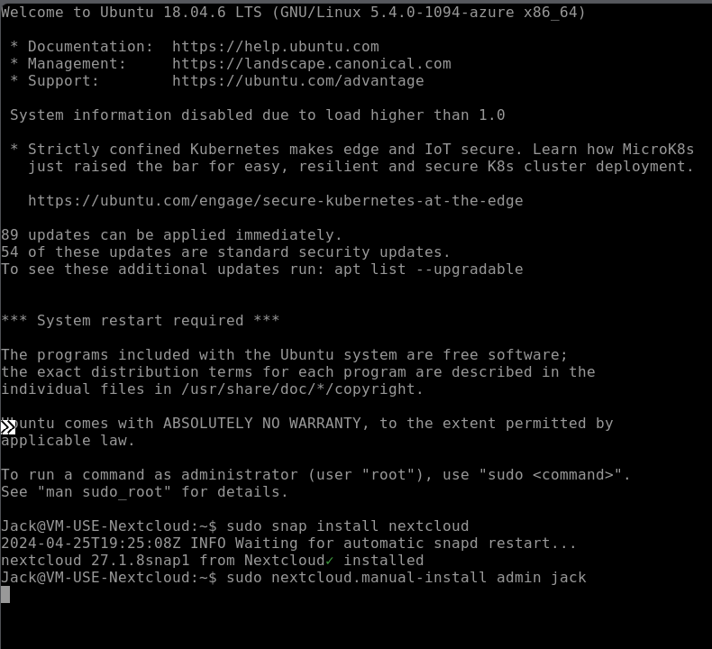
Create Administrative Account
Type sudo nextcloud.manual-install admin jack
Note: Use better usernames and passwords when creating a real account. This is for test only.

Slide 33
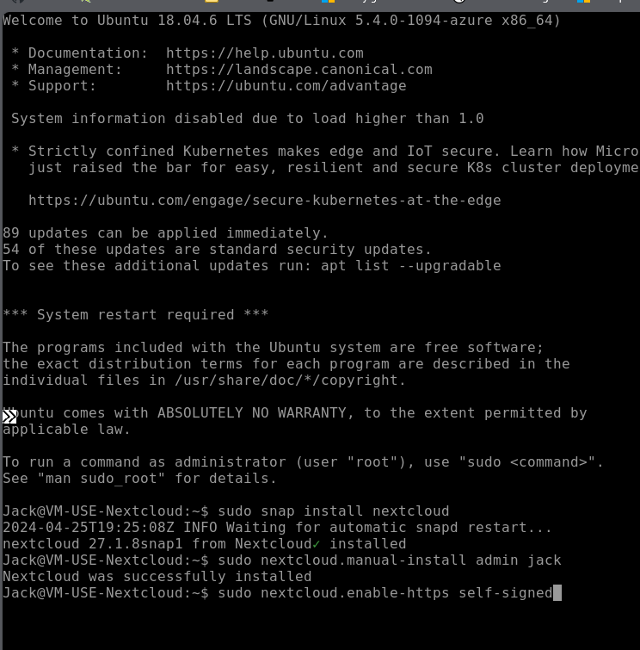
Create a self sign certificate
Type sudo nextcloud.enable-https self-signed
Once certificate is generated type exit to exit the window.

Slide 34
Task 7: Publish an IP

Slide 35
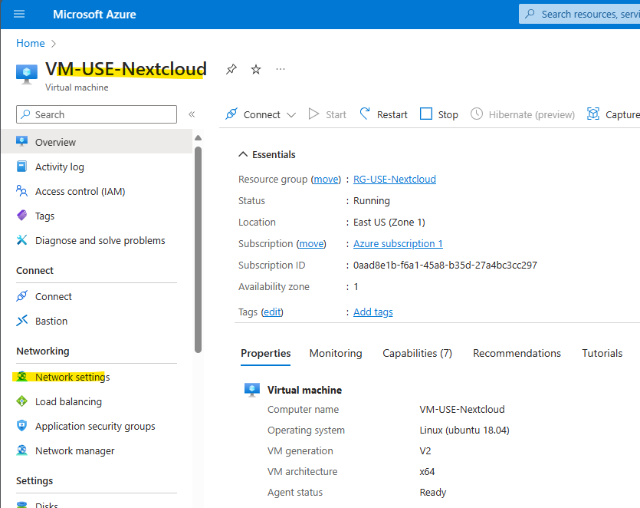
Publish IP Address
Start at the VM
Go to Network Settings

Slide 36
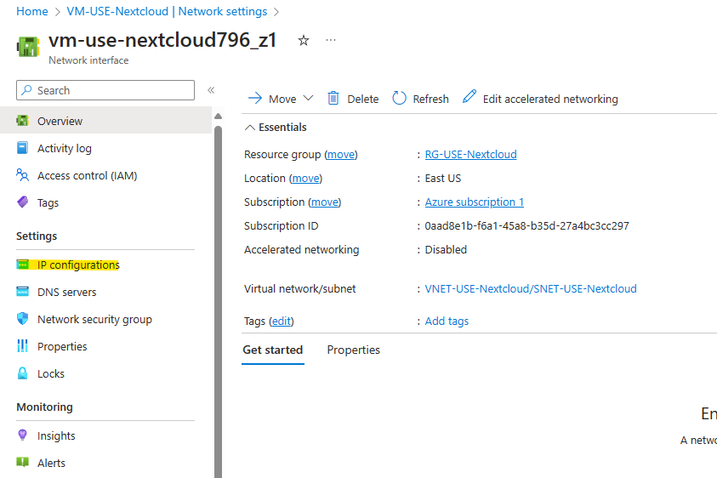
Publish IP Address
Go to the IP Configurations

Slide 37
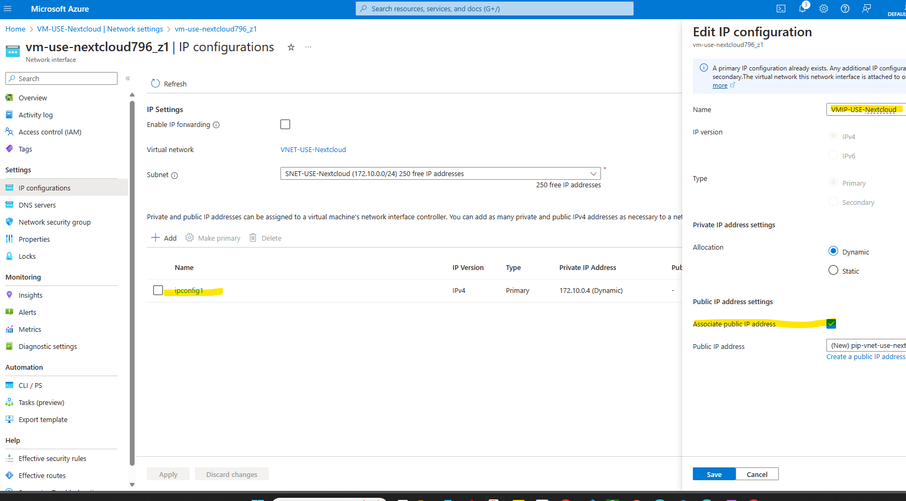
Add Inbound traffic to Add Inbound Traffic Rule
Select ipconfig1
Name the IP configuration
Check Associate public IP address
Click Save

Slide 38
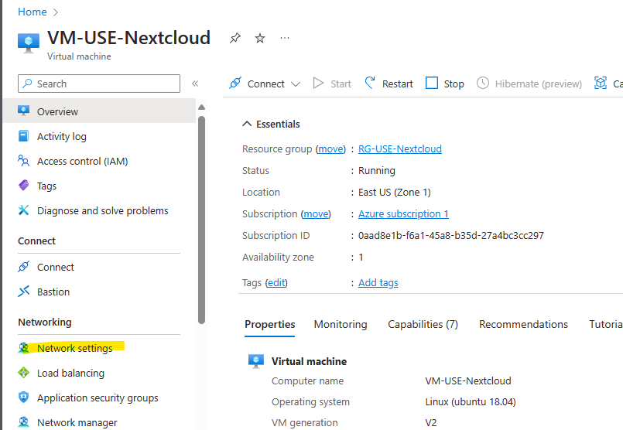
Publish IP Address
Go back to the VM
Then go to Network Settings

Slide 39
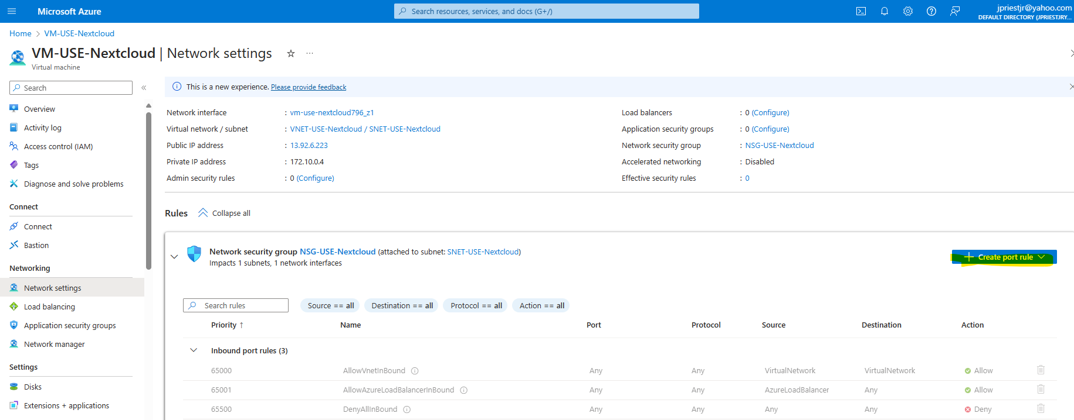
Publish IP Address
Go back to the VM
Then go to Network Settings
The go to + Create port rule

Slide 40
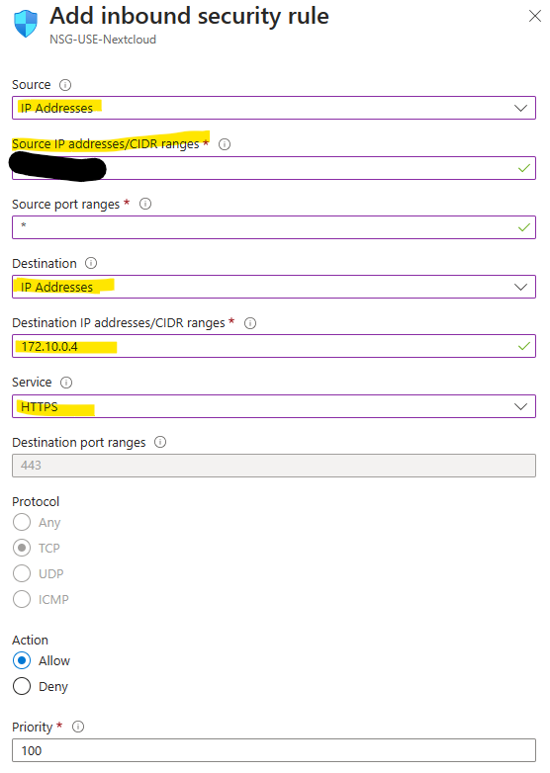
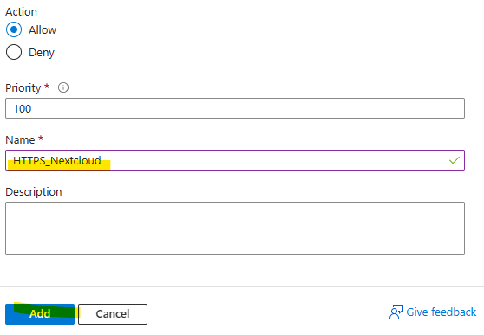
Publish IP Address
Change Source to IP Addresses
Change Soure IP Address to the IP addresses you’d like to have access (such as your own IP).
Change Destination to IP Addresses
Type in IP Address from earlier
Change Service to HTTPS
Change Name of IP Address
Click Add

Slide 41
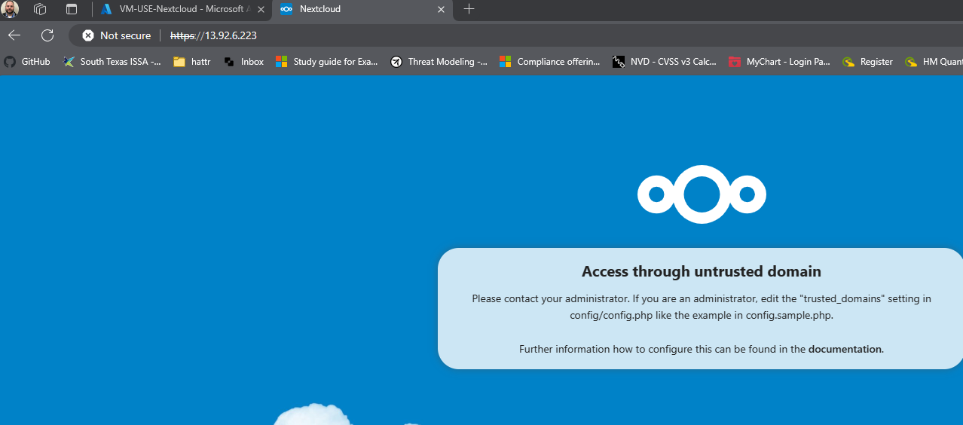
Publish IP Address
Now you can access the site
It shows untrusted as we gave it a self-signed certificate, we will fix this issue in the next step.

Slide 42
Task 8: Create a DNS label

Slide 43
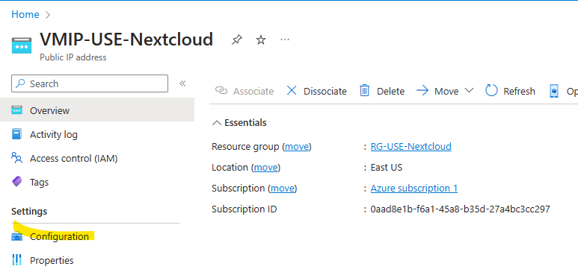
Create a DNS Label
Go back to your VMIP
Click on Configuration

Slide 44
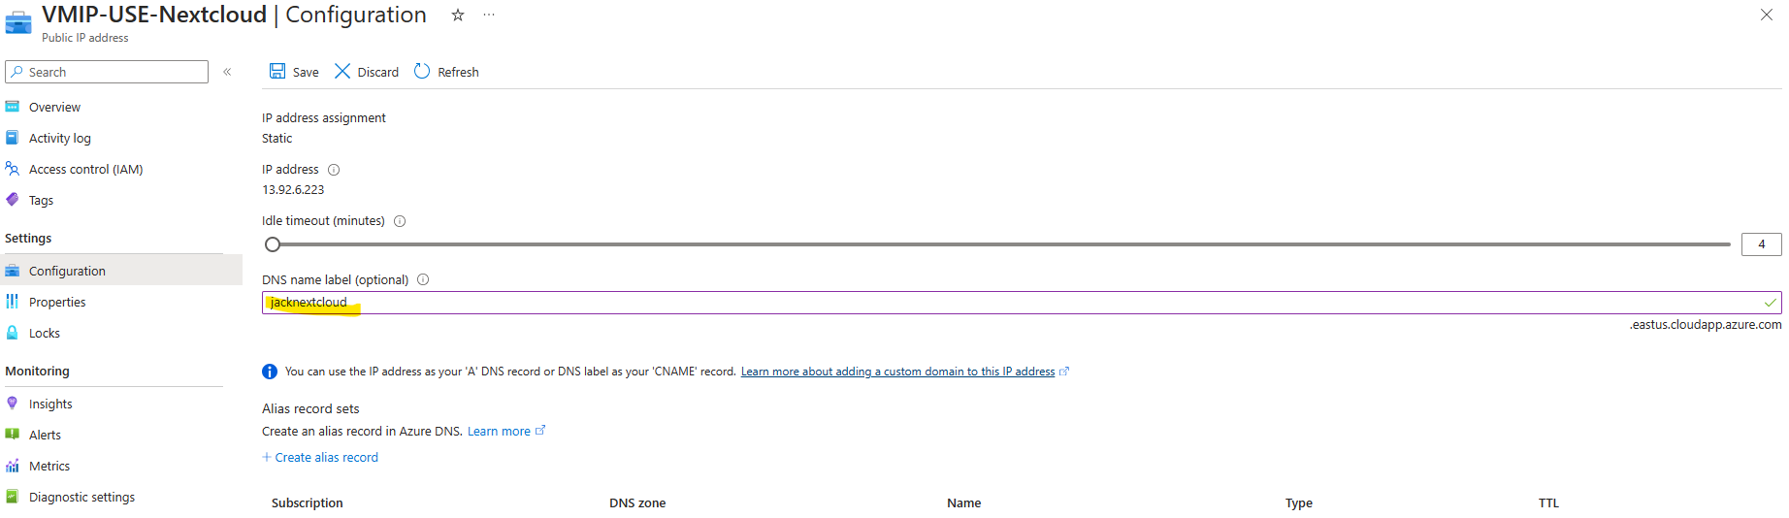
Create a DNS Label
Give your DNS name label a name
Then click save

Slide 45
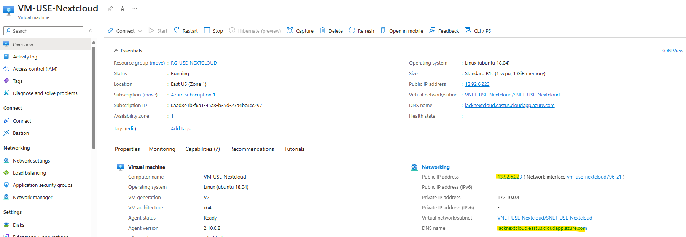
Create a DNS Label
Verify public IP address and the DNS name by going back to the VM Overview

Slide 46
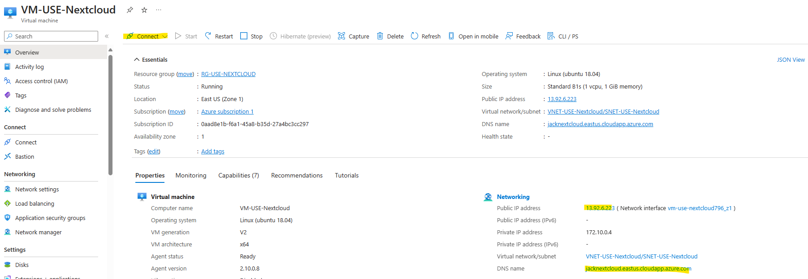
Create a DNS Label
Next Click on Connect and connect via bastion

Slide 47
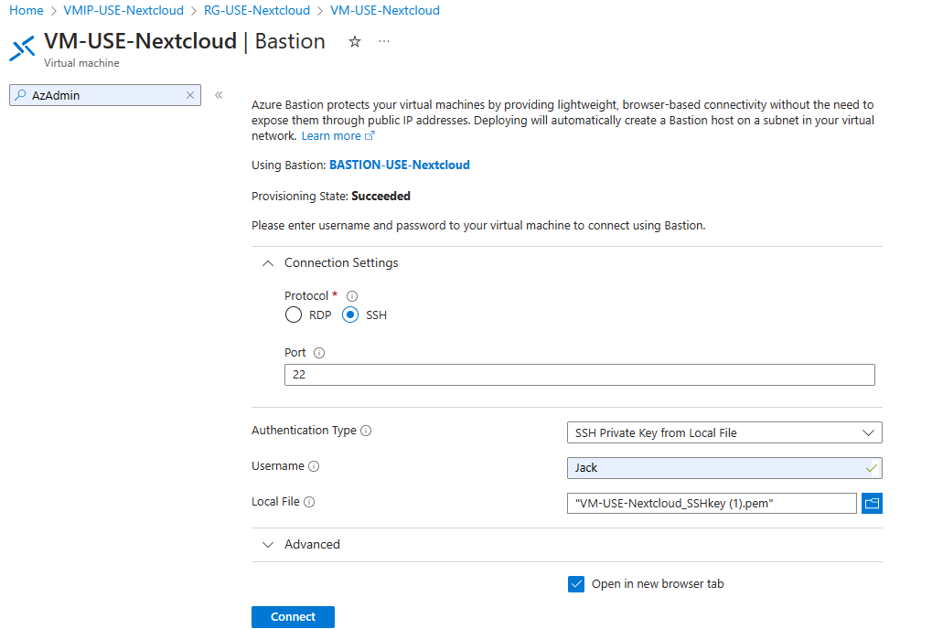
Create a DNS Label
Fill out Auth Type, Username, and local file same as before, and select connect.

Slide 48
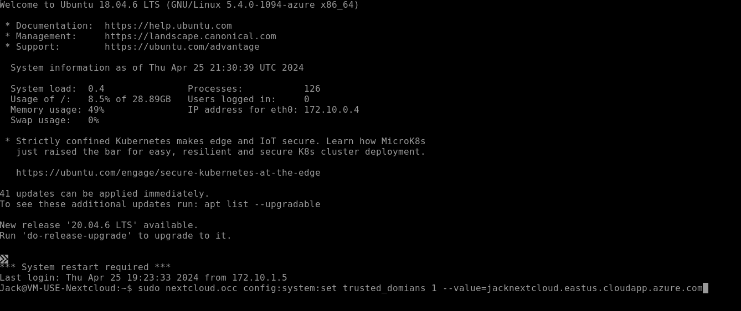
Create a DNS Label
Next type in: sudo nextcloud.occ config:system:set trusted_domians 1 –value=jacknextcloud.eastus.cloudapp.azure.com
*your value will be what you configure in your dns settings.
Then type in exit

Slide 49
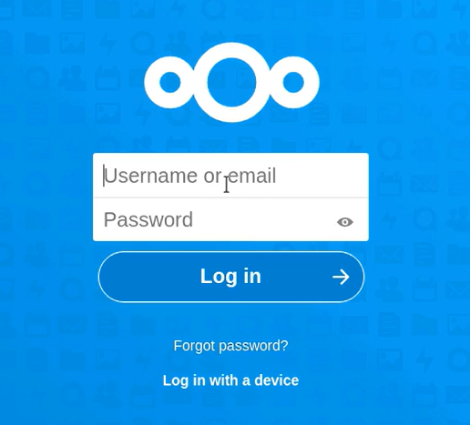
Create a DNS Label
Go to internet browser and type in your DNS name and now you can enter your username and password from earlier and connect to the site.

Slide 50
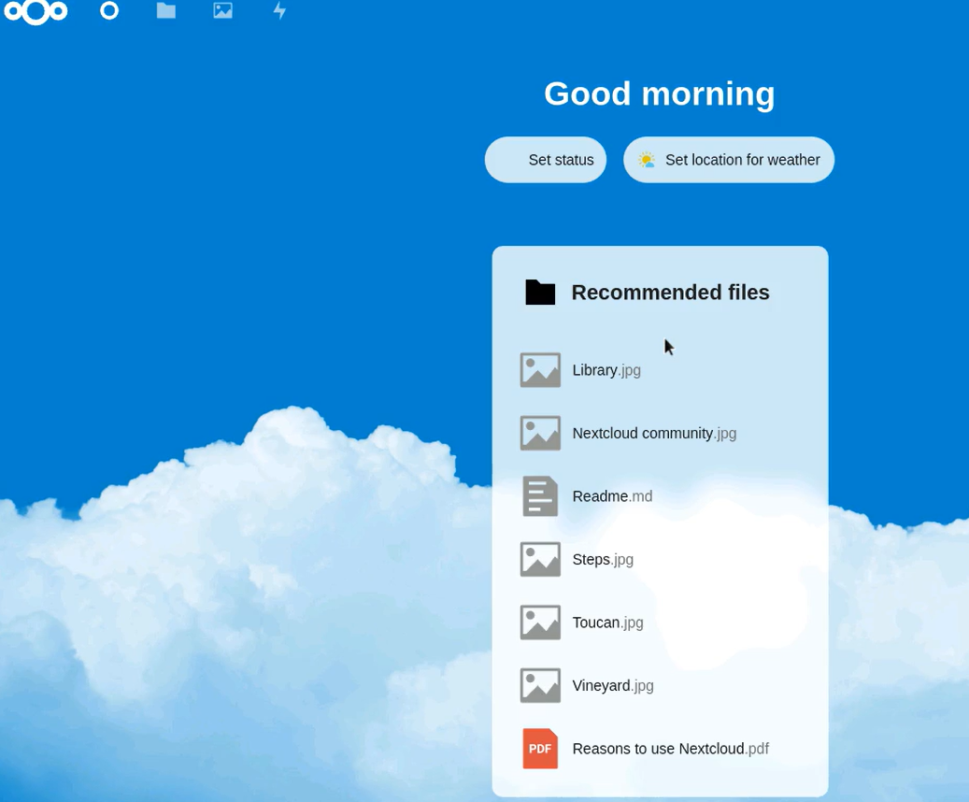
The End

